Slide 1

Excel
Visualize Your Data

Slide 2
What You Will Learn
Data Normalization Basics
Analyze your Data with the Quick Analysis Tool
Gain insights into your data with the Analyze Data Tool
Have fun with Visuals

Slide 3
Data Normalization
What is?
Process
Organizing data
Reduce redundancy
Improve data integrity
Basic Steps?
No duplicates
No blanks
Utilize a key identifier
Meaningful field names
1

Slide 4
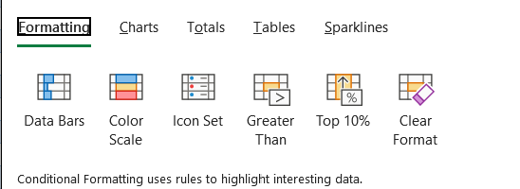
Quick Analysis Tool
Conditional Formatting
Summarize Rows/Columns
Create Visuals
2

Slide 5
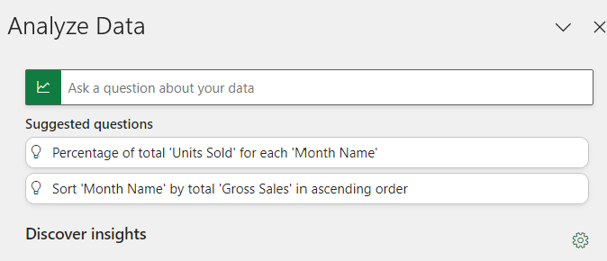
Analyze Data Tool
Ask questions about our data
Generates relevant visuals
Provides Additional Insights
3

Slide 6
Practice
Build a Pivot Table
Visualize with a Pivot Chart
4

Slide 7
Conclusion
Automation is available
Save time with tools
Gain insights with Analyze Data
Visualize and tell a story
End

